Slide 1
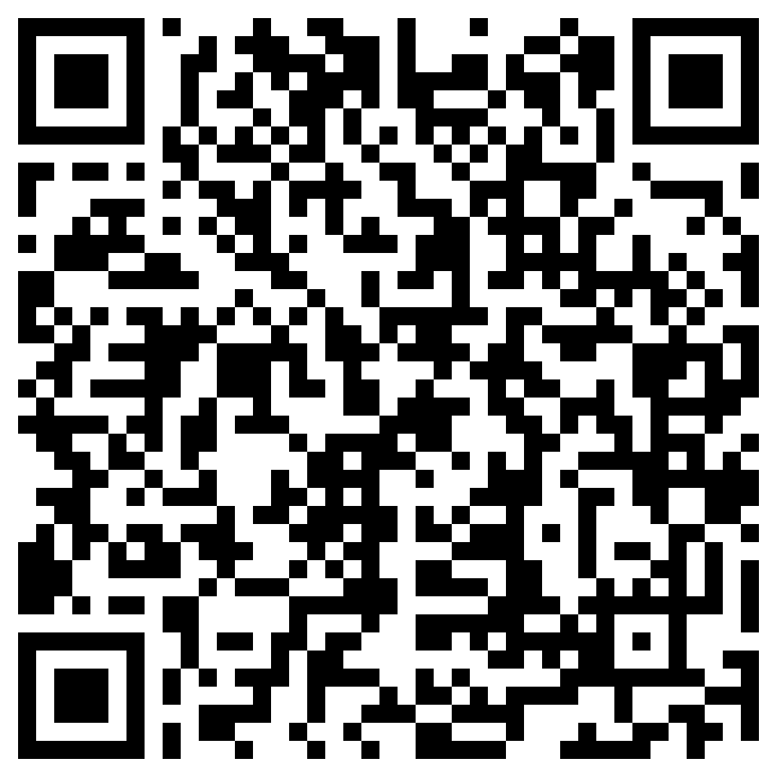
KMHS Soccer Boosters 2023 - 2024 Parent Meeting
While we are waiting to begin, please click the following QR code and fill out the information. Thank you!

Slide 2
Agenda
Introduction of Board
How to get Info – Get Connected!
Financial Responsibility
Fundraising
Parent Requirements
Tryout Deposit
Volunteers
What Happens Next?
Questions/Comments

Slide 3
Who we are
2023-2024 BOOSTER CLUB OFFICERS
Co-presidents - Vince Roldan & Aaron McCreary
Treasurer – Adriana Trueba
Secretary – Priscilla Peixoto
Member At-Large – Kim Bayliss
2023-2024 BOOSTER CLUB COMMITTEE CHAIRS
Communications – Aimee Roldan
Hospitality – TBD
Concessions – Timothy Farmer
Fundraising – TBD
Spiritwear – TBD
Webmaster – Matt Abel

Slide 4
Get Connected & Follow Us
Website – www.kmhssoccer.org
Get Highlights, Scores, Schedules and Photos
Sponsors
Forms and Bylaws
Facebook – kmhssoccer
X – Follow All of the KMHS Soccer Accounts
Booster Club @KMHSSoccerBC
Boys Soccer @kmhsfutbol
Girls Soccer @kmhsgirlssoccer
Instagram – Follow on IG
Girls Soccer – @kmhs_girlssoccer
Boys Soccer – @kmhsfutbol
Email – KMHS.Soccer.Booster@gmail.com – Please email the Booster Club to get on the mailing list.

Slide 5
What Cobb County Provides
Stipend for 1 Varsity and 1 JV Coach per Program
4 Game Balls
Officials

Slide 6
What Do My Dues Support
2024 Dues – Varsity $600 / JV $500
Community Coaches
Practice Shirts
Team Hoodies
Uniforms
Awards
Senior Gifts
Photography
Practice Field Maintenance
Nets
Extra Game Balls
Coach’s Gear
Website Hosting
Accounting Software
Veo Video Recording system

Slide 7
Varsity Trip
Varsity Boys and Girls – Spring Break Trip
Hilton Head Island, SC
3 Days, 2 Games (local SC High Schools)
Tail-end of Spring Break week – April 4-6th, 2024
Cost Per Player – TBD
Still getting reservations & logistics planned
Will have final numbers at tryouts

Slide 8
Ways to Pay:
Venmo - @KMHS-Soccer - (please note your child’s name)
Zelle - KMHS.Soccer.Booster@gmail.com
Cash or Check: Payable to KMHS Soccer Booster Club – delivered to a board member

Slide 9
Fundraising
Option | Price | Amount to Player Account | Amount to Booster Club | Expense (Cost of Item)
Banner(s) | $400 | New - $225 Returning - $270 | New - $0 Returning - $0 | New - $100 Returning - $30
Chick-fil-a Raffle* | $5 per ticket | $0 | 100% | $0
Buyout Option | $100 | $0 | 100% | $0
*Participation is Mandatory
– Each Player is required to sell 20 tickets ($5 per ticket) unless they pay the buyout fee of $100.

Slide 10
Parent Requirements
Work the Concession Stand ($50 fine for no-show)
Provide One Team Meal
Assist Transporting Player, if needed
Get Connected & Support the Club

Slide 11
Tryout Deposit
$250 due no later than 1st day of tryouts
(01/16/24)
Deposits will be held until teams are announced.
Players who pay deposit get first choice of jersey # based on seniority.
If your child is not selected for the team, your money will be refunded the week after announcements.
Ways to Pay:
Venmo - @KMHS-Soccer - (w/child’s name)
Zelle - KMHS.Soccer.Booster@gmail.com
Cash or Check: Payable to KMHS Soccer Booster Club – delivered to a board member

Slide 12
Volunteers Needed!
The Booster Club needs parent involvement to be successful and to make sure the players have everything they need to have a great season.
Volunteer Opportunities:
Spiritwear
Fundraising
Social Media Reps
Team Moms/Dads
Concessions Reps
Hospitality Reps
Gate Workers
Photographers
Please email to plug in KMHS.Soccer.Booster@gmail.com

Slide 13
What Happens Next?
Activity | Details | Date
Player Info Form | QR form will keep you in the know! | ASAP
Physicals | Physicals MUST be initiated in and uploaded to ParentVUE | Prior to Conditioning or First Day of Tryouts, if not doing conditioning
Conditioning | Each program (boys and girls) will hold conditioning sessions prior to tryouts | Physicals will need to be in before participation.
Tryouts | Boys – January 16 - 19, 2024 Girls – January 16 – 19, 2024
Stadium Cleanup | All players & parents to clean up stadium and pressure wash team shelters. | January 13th, 2024 9AM to 12PM
Teams Announced | Posted on www.kmhssoccer.org | Girls - January 19th by 9 PM Boys – January 19th by 9 PM
Kickoff Event | Pictures, Socks ($30), JV vs Varsity Scrimmage & Dinner | January 26th

Slide 14
Recap
Get connected – Remind, Website, QR code, Twitter, Email
Beginning in January 2024
Pay try out deposit ($250)
Tryout – starts 01/16/2024
Pay your dues - $600 Varsity and $500 JV
Fundraise or pay to opt out - $100
Review Parent Requirements
Get involved – Volunteer! KMHS.Soccer.Booster@gmail.com
Questions??

